Slide 1
Machine Learning Bootcamp IDUG NA 2019: June 6, 2019 Mark Ryan Jason Shayer Steve Darling
Notes:
Thanks for coming
Preview of bootcamp we will be presenting in a month at IDUG (international Db2 Users Group) in Charlotte NC
Purpose of this runthrough is to validate the material and learn what glitches can occur in the hands-on portion of the session
Feel free to stop us if you have a question
I’ll be speaking for about 20 minutes to introduce some aspects of machine learning and the problem that we will be solving in the hands-on portion of the day
To prepare for the hands on portion
Has everybody downloaded the repo and installed WS Desktop?
If you haven’t installed WS Desktop – take a moment now to start the download
If you have installed WS Desktop, please take a moment now to start it
Go into a project and add a notebook and let that cook

Slide 2
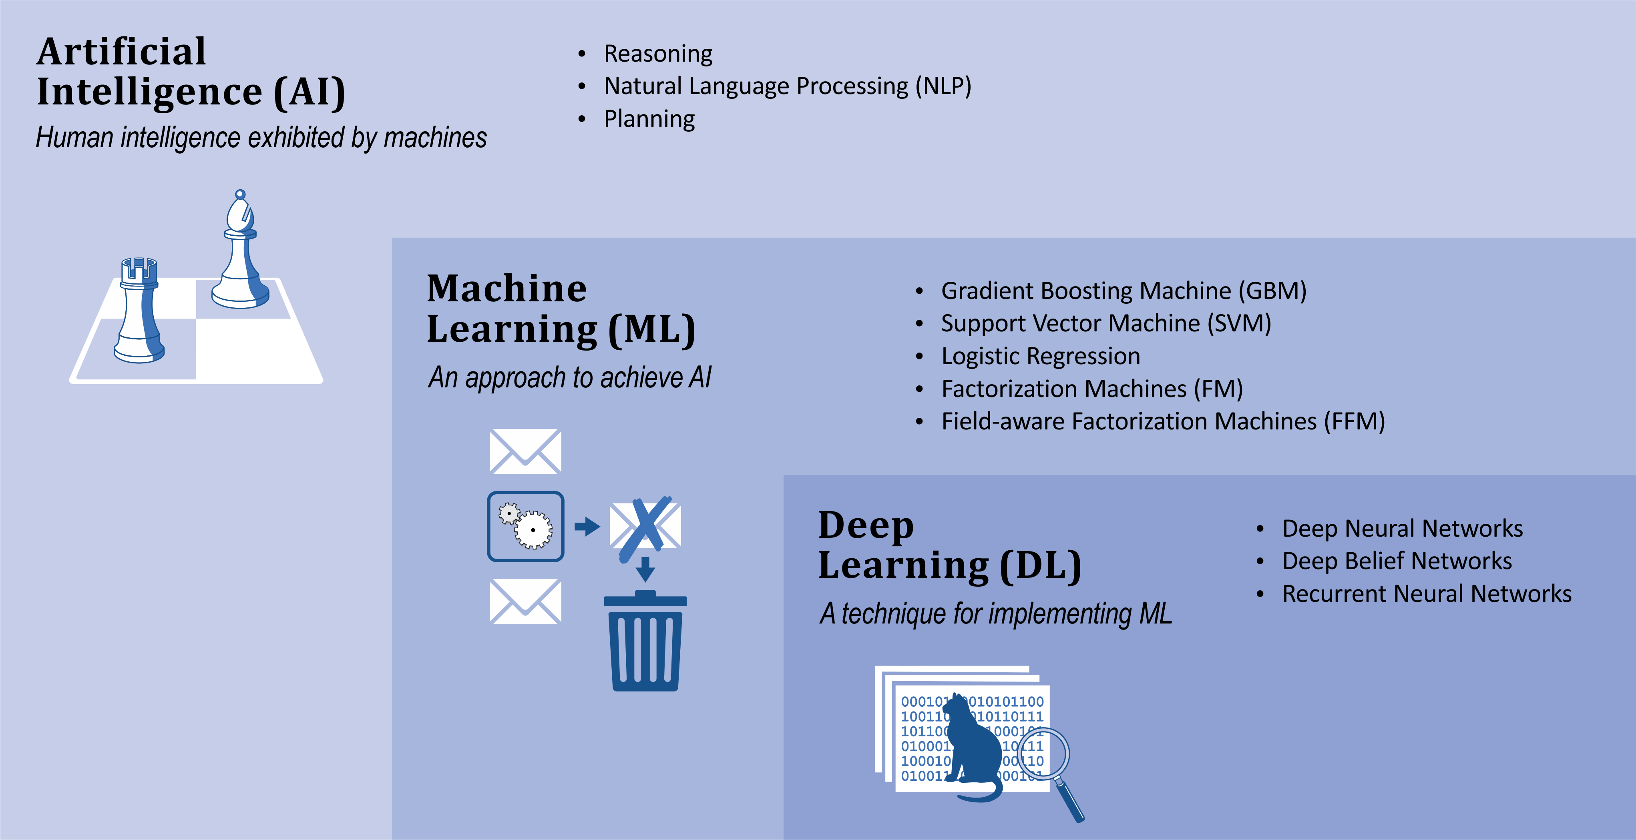
What is Machine Learning?
Notes:
Artificial Intelligence (AI) is the broadest concept of machines being able to carry out tasks that mimic human capabilities:
Once such a capability has been mastered it may no longer be called AI e.g. Deep Blue’s win against world champion chess player Garry Kasparov in 1996.
Examples of AI at the time of unveiling: IBM’s Watson win at Jeopardy in 2011
Google’s AlphaGo win against top Go players in 2016 are good examples of significant AI achievements.
Reasoning, planning, and natural language understanding are AI capabilities.
Machine Learning (ML)
an AI capability based around the idea that we should be able to give machines access to data and let them learn for themselves
a machine “learns” if it gets better at performing a specific task as it gains experience.
For instance, an email spam detector might get better at differentiating between valid emails and spam by “learning” from emails that are discarded as spam.
Deep Learning (DL)
a class of machine learning algorithms that produce models composed of deep neural networks
Compared to non-DL, or classical ML algorithms, DL achieve world-class performance in a set of important applications, including image recognition and machine translation
Take the same “secret sauce” that makes common classical ML algorithms work (defining a loss function to describe the delta between the actual outputs of a given set of inputs and the predicted output from the model; and using derivatives of that loss function to determine how to update weights in the model to minimize the loss function and thus maximize the accuracy of the prediction) and generalize it to work across multiple layers of weights
You are sitting here today because of the accomplishments of deep learning – classical ML continues to provide value in many applications and has important advantages (including requiring less data and being much more explainable), but the breakthroughs, headlines, promise and concern is because of deep learning
The starting gun of the deep learning revolution was in 2012 when a team using a deep learning approach achieved a result on Imagenet (an image recognition challenge) that was an order of magnitude better than what had been accomplished up to that point
While the math behind deep learning is decades old, the flashpoint was only 7 years ago, and it’s only in the subsequent 5 years or so that the combination of stable usable frameworks, cheap (especially cloud) hardware, and accessible learning materials has made DL of interest to non-specialists

Slide 3
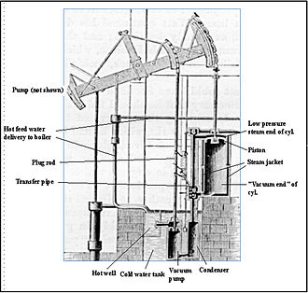
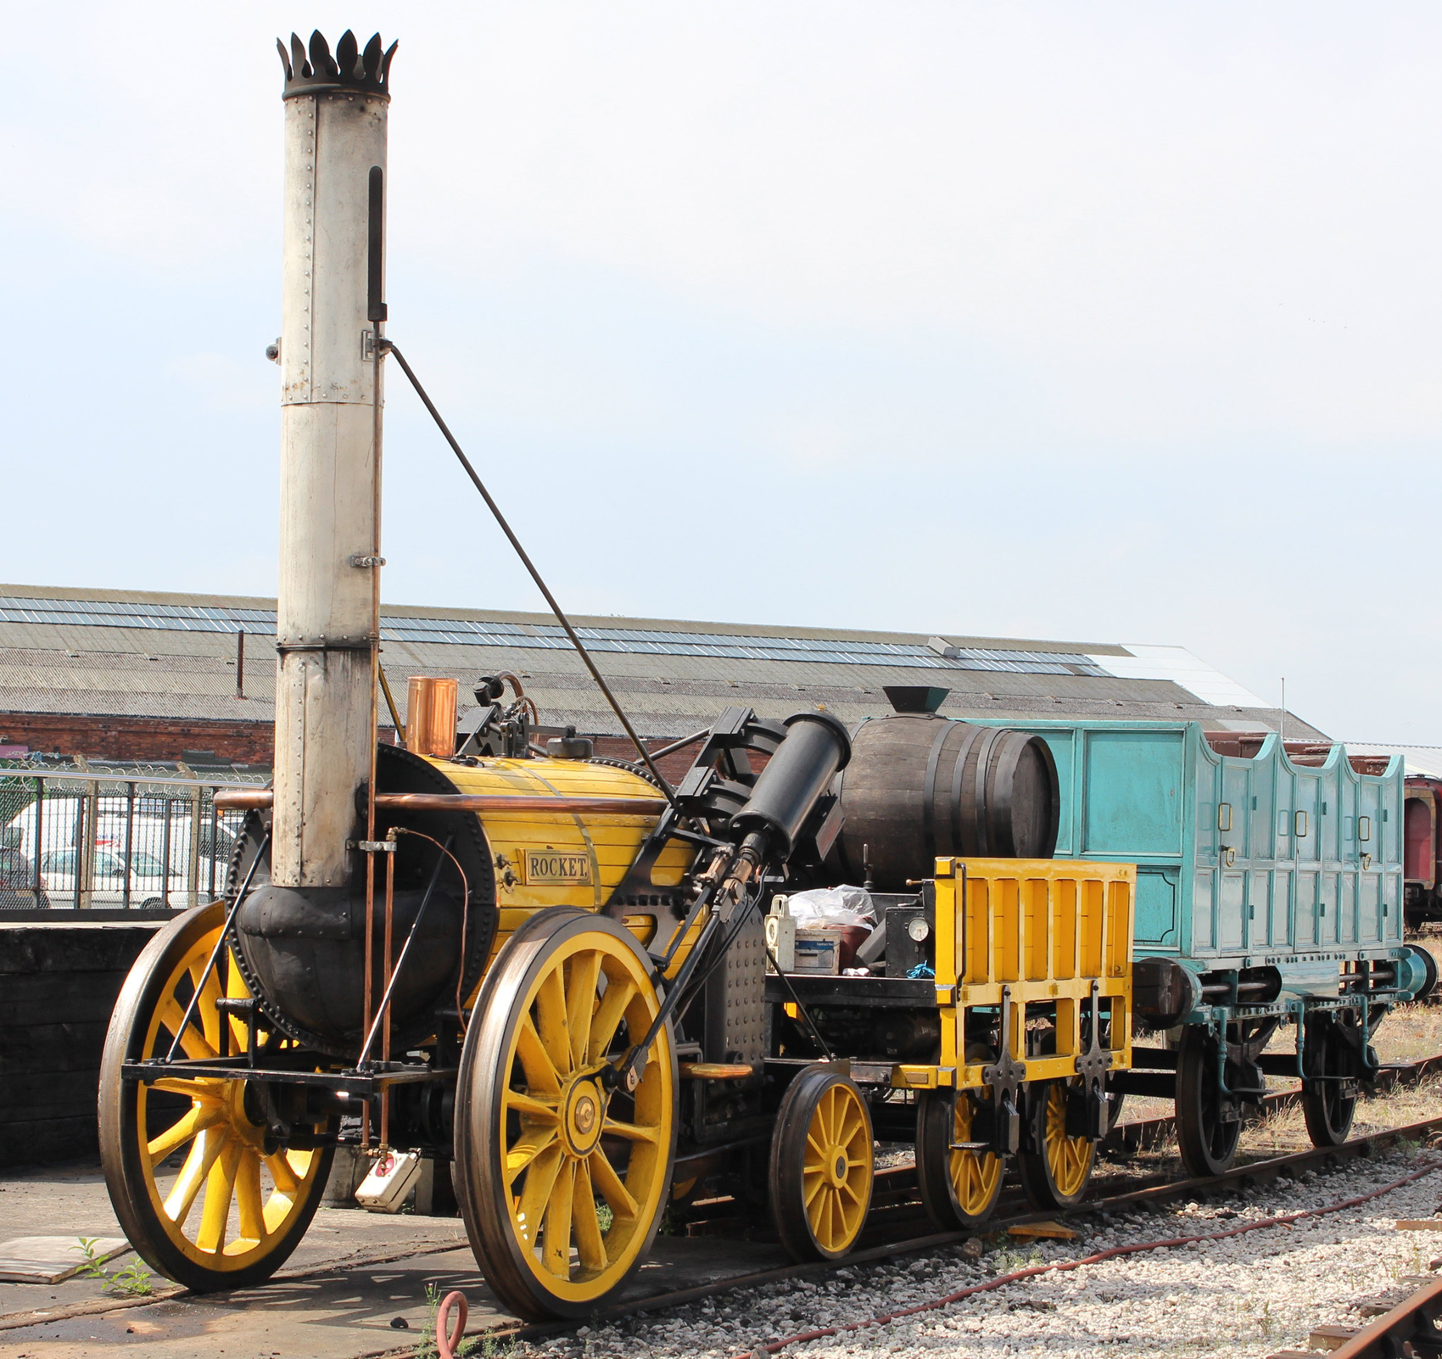
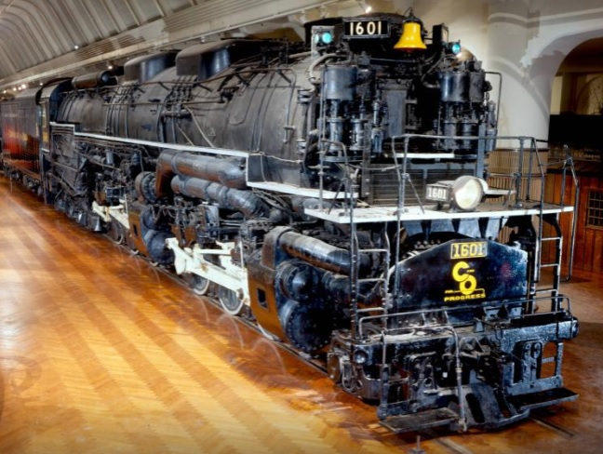
What is Machine Learning?
1770’s:
Watt’s stationary engine
ML era: late 2000s / early 2010s
1829:
Stephenson’s Rocket
ML era: 2019
1941:
Alleghany locomotive
ML era: 5-10 years from now?
Notes:
Robert H. Thurston - Thurston Robert H: History of the Growth of the Steam engine, D. Appleton & Co 1878 WATTS
Rocket reconstruction: https://www.american-rails.com/stephensons-rocket.html#gallery[pageGallery]/4/
Alleghany locomotive: https://www.thehenryford.org/collections-and-research/digital-collections/artifact/9628#slide=gs-187634
Pulled from service after only 11 years
Analogy – it has taken time for ML to become useful in a context that isn’t specialized and backed with tons of exotic hw
The equivlent to Rocket is tons of data, cheaper (cloud) hw, stable common frameworks, and accessible training
Deep Learning: Henry J. Kelley is given credit for developing the basics of a continuous Back Propagation Model in 1960. In 1962, a simpler version based only on the chain rule was developed by Stuart Dreyfus. While the concept of back propagation (the backward propagation of errors for purposes of training) did exist in the early 1960s, it was clumsy and inefficient, and would not become useful until 1985.
This was when Seppo Linnainmaa wrote his master’s thesis, including a FORTRAN code for back propagation. Unfortunately, the concept was not applied to neural networks until 1985. This was when Rumelhart, Williams, and Hinton demonstrated back propagation in a neural network could provide “interesting” distribution representations.
In 1989, Yann LeCun provided the first practical demonstration of backpropagation at Bell Labs.
The next significant evolutionary step for Deep Learning took place in 1999, when computers started becoming faster at processing data and GPU (graphics processing units) were developed
In 2009, Fei-Fei Li, an AI professor at Stanford launched ImageNet, assembled a free database of more than 14 million labeled images. The Internet is, and was, full of unlabeled images. Labeled images were needed to “train” neural nets. Professor Li said, “Our vision was that Big Data would change the way machine learning works. Data drives learning.”
One example is AlexNet, a convolutional neural network whose architecture won several international competitions during 2011 and 2012. Rectified linear units were used to enhance the speed and dropout.

Slide 4
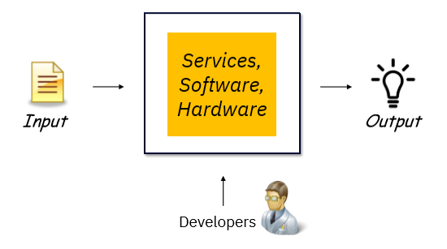
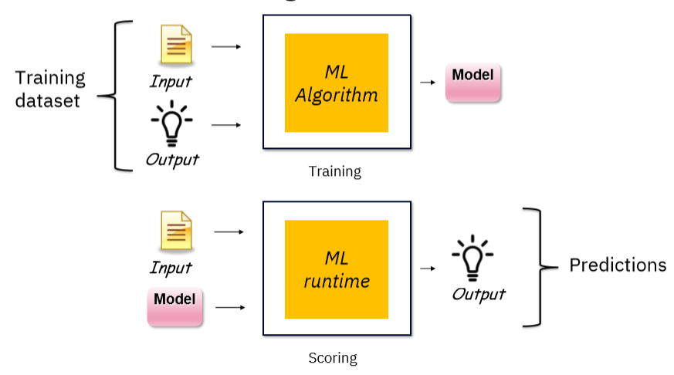
What is Machine Learning?
Classical Programming
Machine Learning
Notes:
Classical Programming:
Data is processed through code that is created by a developer to produce an output.
The behaviour of the code may depend on the input data, but the code itself is immutable (with the exception of overloading functions to have different behaviour based on the type of the argument with which it is called – but even there the developer explicitly specified the behaviour)
Machine Learning
The code organizes itself, determines its behaviour relative to input it sees when it is deployed, based on the data it has seen in the training phase.
By showing the ML algorithm the input and the actual output (for example, the number of rooms and square footage of houses, along with their selling prices), you get a trained model
Once you have a trained model, you feed it and (new) input data into the ML runtime to get predictions
You still have coding to do with machine learning – you will see some of the steps it takes to prepare data to train a model, and ML algorithms are still picky about what kind of data they can be trained with – but the lines of code where the model is trained can:
Very short
Boilerplate
There are aspects of getting value out of machine learning applications that are different than classical programming:
Tracking model accuracy – assessing whether the model continues to make accurate predictions on new data
Retraining – updating models to ensure that accuracy standards are maintained

Slide 5

Customer churn: use case to illustrate machine learning
Customer churn: when a customer ends their relationship with a business
PROBLEM: You need to predict which of your customers are loyal and which are at risk of churning
SOLUTION: Use data you have about clients to build a model that can predict whether a given client is going to churn
Notes:
Customer Churn – a real problem for real businesses
We will be looking at data from a mobile / internet service provider

Slide 6
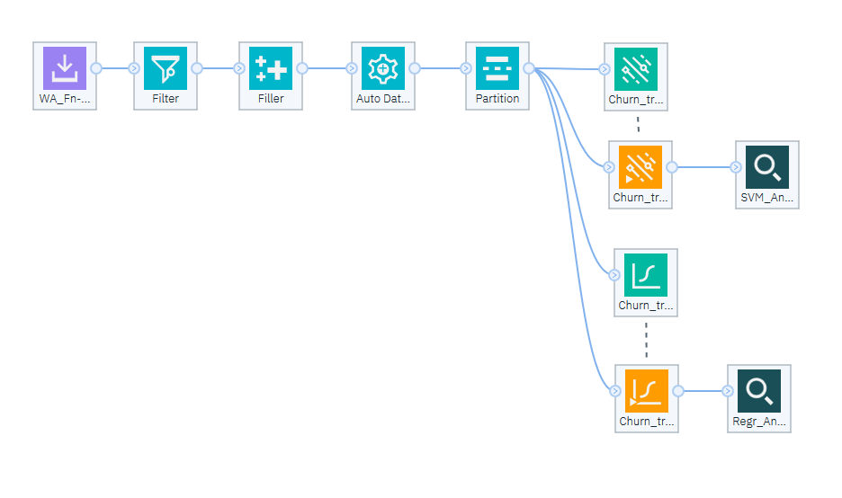
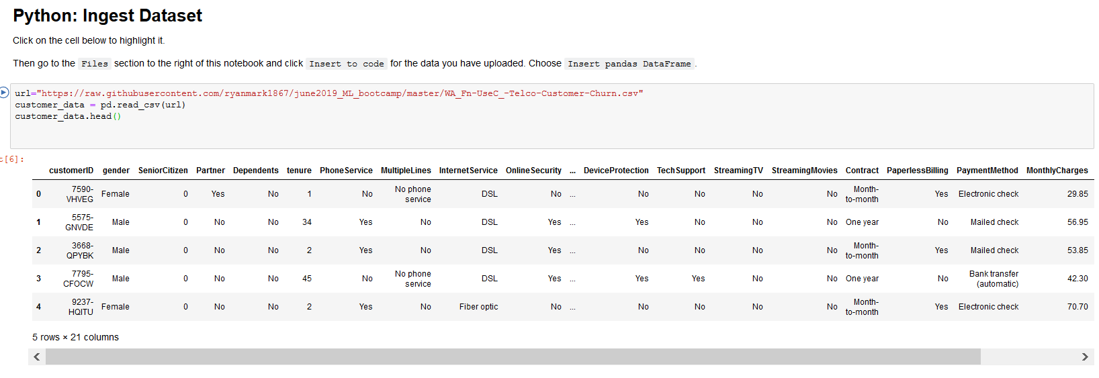
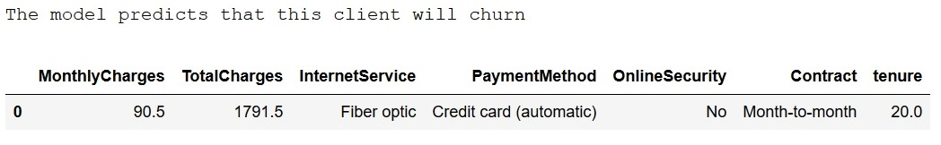
Customer Churn: the game plan
1
Solve the customer churn problem using Modeler
2
Solve the customer churn problem using Python
3
Define a pipeline in Python to predict if a client will churn
Notes:
This is primarily a hands on session
Once we have explored the problem in a bit more depth we will get into building models for prediction
First we will use Modeler to create a no-code solution
Using what we learned there, we will examine a coded solution to the same problem, coded in a notebook in Python
By giving you the chance to create a model yourself at a higher level of abstraction and see how the data is prepared, hope that the code will make more sense
We won’t be giving you a comprehensive introduction to Python or covering all aspects of data science. Rather, we will show a fastpath to creation of simple machine learning models for solving a real-world problem.

Slide 7
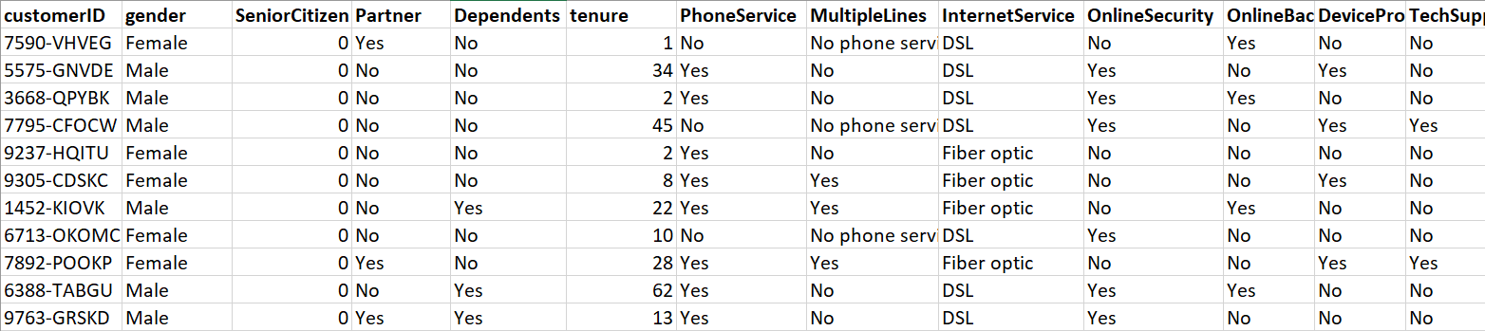
Customer churn: dataset
CSV (comma separated values) file with ~7k records; 21 columns
Numeric columns: tenure, MonthlyCharges, TotalCharges
Categorical columns: gender, SeniorCitizen, Partner...
Target / Label: Churn
Notes:
In machine learning the data defines what the code does
So it’s important to understand the characteristics of the input data, the dataset,
It’s a CSV (comma separated values, readable raw or in Excel) file. A row for every customer record and a column for every characteristic – a table
One very special column is the Churn column (churn yes or No) – this is the value that our model will predict

Slide 8
Customer churn: preparing the dataset for ML
Original dataset
Why?
Keep a subset of columns
Pick just the columns needed for the model
Deal with missing values
ML algorithms need numeric input
Deal with outliers
Scale continuous values
Deal with string values
Control impact of anomalies
Consistent impact of columns
ML algorithms need numeric input
Split Dataset into Train & Test
Need to reserve a portion of the data the model has never seen to validate the model
Notes:
Most of ML is data preparation – this will be especially evident in the Python notebook where you will see most of the code is prep for the ML algorithm
SOME ESSENTIAL POINTS OF ML:
ML algorithms can only be fed numeric data. Non-numeric data needs to be turned into numbers
You need to hold back some of the dataset, not show it to the model when you are training so you can use it to test the model

Slide 9
Customer churn: preparing the dataset for ML
Original dataset
Keep a subset of columns
Pick the 8 columns needed for the model:
tenure
InternetService
OnlineSecurity
Contract
PaymentMethod
MonthlyCharges
TotalCharges
Churn
Deal with missing values
Deal with outliers
Scale continuous values
Deal with string values
Split Dataset into Train & Test
Notes:
You will need to use this list of the subset of columns later
Note that in data science picking these columns (the features) can be an involved process to get the right balance of efficiency and accuracy. For this exercise we are picking these columns and going with them for the sake of simplicity. As you will see, they generate a model with decent accuracy.

Slide 10
Customer churn: the pipeline
Original dataset
Split Dataset into Train & Test
Keep a subset of columns
Pipeline:
Train the data preparation steps and the model in one operation
Apply pipeline to get a churn / no churn prediction for a given client
Performs data prep on client’s data
Applies model to get a prediction
Deal with missing values
Deal with outliers
Scale continuous values
Deal with string values
Logistic Regression model
Notes:
Most of ML is data preparation – this will be especially evident in the Python notebook where you will see most of the code is prep for the ML algorithm
SOME ESSENTIAL POINTS OF ML:
ML algorithms can only be fed numeric data. Non-numeric data needs to be turned into numbers
You need to hold back some of the dataset, not show it to the model when you are training so you can use it to test the model

Slide 11

Machine learning models: Logistic Regression
Classification: churn / no churn
Extension of linear regression
simplest algorithm; used to predict continuous values
e.g. predict house price from # of bedrooms, sq. ft, frontage
Logistic regression is “geared” to output between 0 and 1
treat 0.5 as the boundary
With X (input) and Y (outcome):
Define function: Ŷ = aX + b
Ŷ is the prediction (churn)
X (tenure, InternetService, etc) is the input; a is the weights; b is the offset
Notes:
Logistic regression models the probabilities for classification problems with two possible outcomes. It’s an extension of the linear regression model for classification problems.
Instead of fitting a straight line or hyperplane, the logistic regression model uses the logistic function to squeeze the output of a linear equation between 0 and 1. The logistic function is defined as:
logistic(η)=11+exp(−η)
https://christophm.github.io/interpretable-ml-book/logistic.html
An adaptation of linear regression
Linear regression: https://christophm.github.io/interpretable-ml-book/limo.html#limo
Implementation of linear regression:
https://towardsdatascience.com/linear-regression-using-gradient-descent-97a6c8700931
Y = Mx + c
Gradient descent is an iterative optimization algorithm to find the minimum of a function. Here that function is our Loss Function.

Slide 12

Machine learning models: the secret sauce
Define a loss function (delta between predictions and actual values):
Ŷ vs. Y
Repeatedly update a (weights) and c (offset) using the loss function:
Calculate the partial derivative of the loss function with respect to the weight and offset
Update the weight and offset by their respective partial derivatives
Making updates to the weights based on “the slope” of the loss function will reduce the loss function -> increase the accuracy of the prediction
Notes:
Logistic regression models the probabilities for classification problems with two possible outcomes. It’s an extension of the linear regression model for classification problems.
Instead of fitting a straight line or hyperplane, the logistic regression model uses the logistic function to squeeze the output of a linear equation between 0 and 1. The logistic function is defined as:
logistic(η)=11+exp(−η)
https://christophm.github.io/interpretable-ml-book/logistic.html
An adaptation of linear regression
Linear regression: https://christophm.github.io/interpretable-ml-book/limo.html#limo
Implementation of linear regression:
https://towardsdatascience.com/linear-regression-using-gradient-descent-97a6c8700931
Y = Mx + c
Gradient descent is an iterative optimization algorithm to find the minimum of a function. Here that function is our Loss Function.

Slide 13
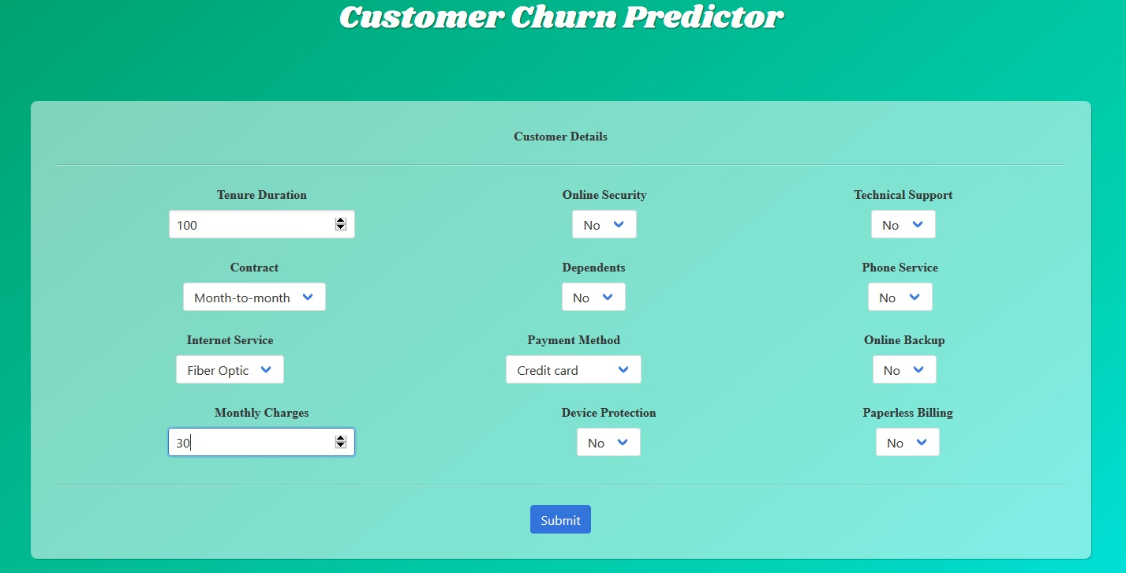
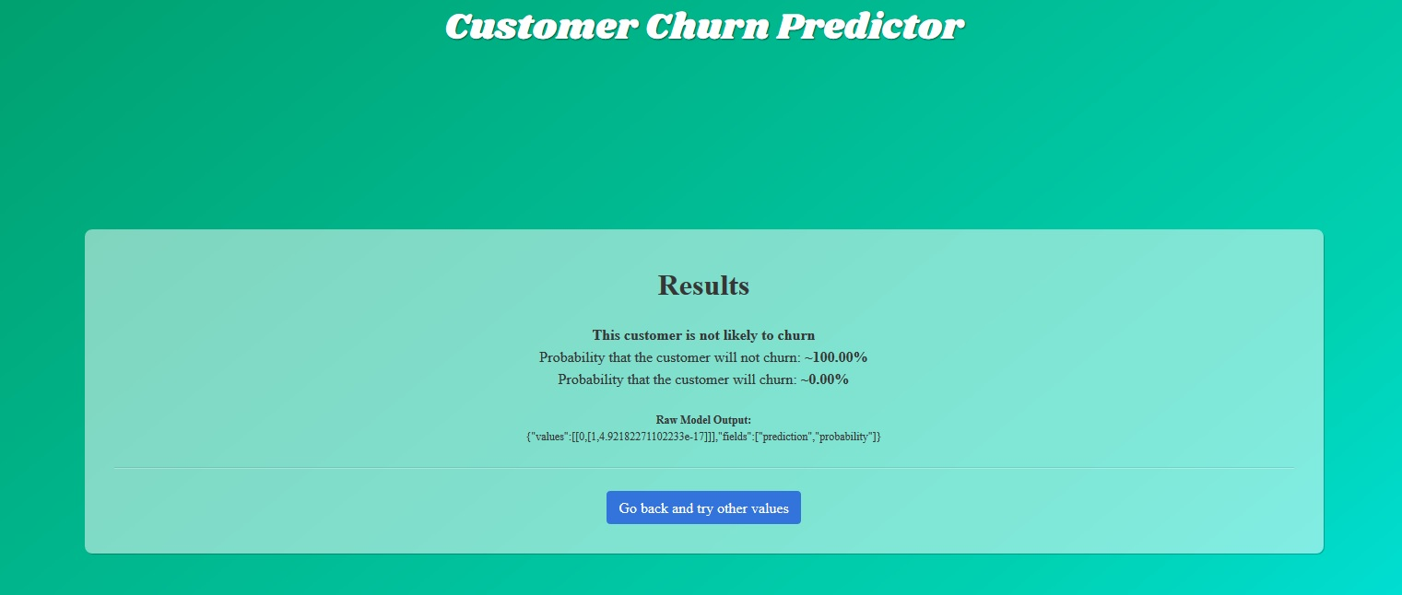
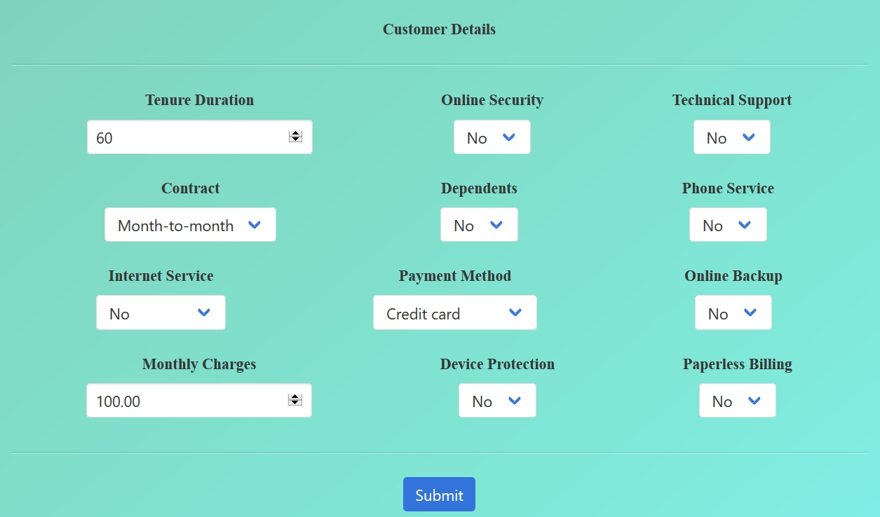
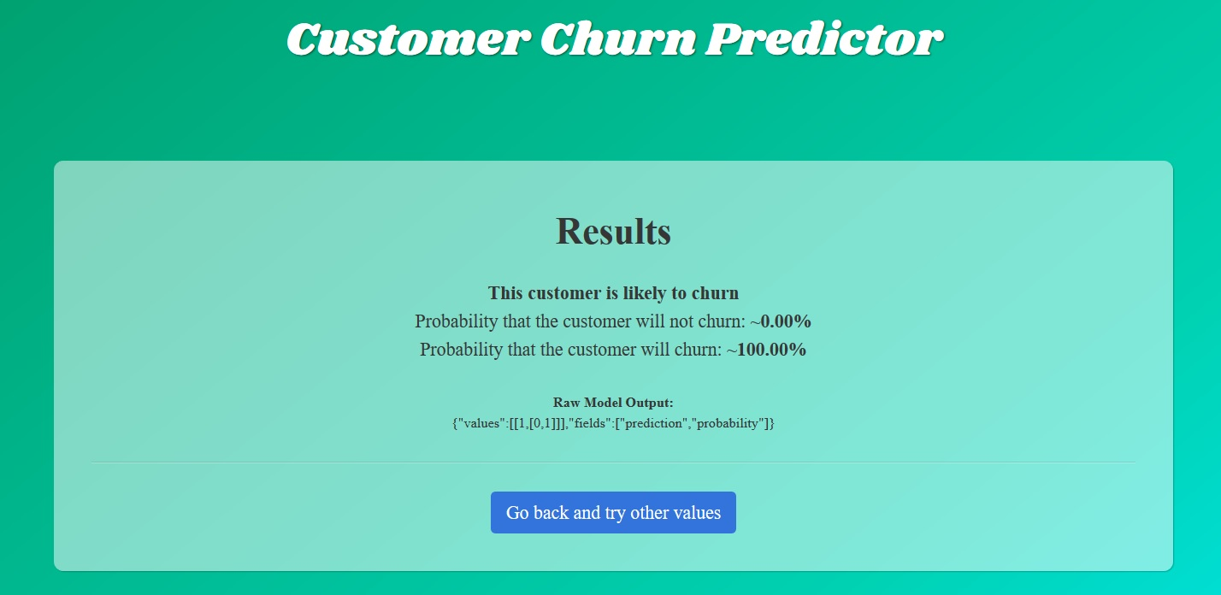
Customer churn: exercising the model
Using the full-blown Python project, you can deploy and exercise the model:
Notes:
What we will cover in the hands-on exercise is training the model and assessing its accuracy against the test dataset.
In a real application you need to deploy the model, that is make it available for ad hoc queries or, more likely, integrate it into a workflow to automatically assess new information. As data changes you need to be able to assess the model’s effectiveness, retrain it, and replace it.
We won’t go through that in 2 hours. However, you can see how a version of the model scores new data by toing to the URL here and entering values – examples shown here of new clients that the model predicts will and won’t churn. As you play with this you’ll see that some values will generate less conclusive predictions.
To see a midway result, keep all defaults with tenure = 40, internet = fibre optic, monthly charges = 30

Slide 14
®

Slide 15
Color palette
R-0 G-0 B-0
R-110 G-23 B-125
R-0 G-15 B-94
R-255 G-255 B-255
R-110 G-23 B-125
R-0 G-15 B-94
R-234 G-234 B-234
R-31 G-179 B-207
R-0 G-59 B-201
R-234 G-234 B-234
R-31 G-179 B-207
R-0 G-59 B-201
R-219 G-38 B-99
R-105 G-166 B-255
R-0 G-100 B-255
R-219 G-38 B-99
R-105 G-166 B-255
R-0 G-100 B-255

